Slide 1


Memory Management In OS
Guided By:
Yuvarani R
CSA0405 – Operating Systems Of File System Implementation.
Saveetha School of Engineering,
SIMATS.
Work Done By:
K. Someshwar Reddy
(192210045)
B. Revanth Harsha Vardhan
(192210076)

Slide 2
ABSTRACT:
The project will focus on developing a memory management module for an operating system environment..
Modern operating systems depend on memory management to enable effective use of system resources and guarantee continuous process execution. .
This abstract presents a comprehensive overview of memory management principles and proposes a project aimed at implementing a simplified memory management system.
The project aims to provide hands-on experience in understanding the intricacies of memory management in operating systems. Through this project, participants will enhance their understanding of fundamental operating system concepts while honing their programming skills in systems development.

Slide 3
INTRODUCTION:
Memory management is a fundamental aspect of operating systems, playing a pivotal role in ensuring efficient utilization of system resources and seamless execution of processes.
Memory management involves several key functions, including memory allocation, deallocation, and optimization. Allocation entails assigning memory blocks to processes based on their requirements, while deallocation involves releasing memory once it is no longer needed.
Moreover, memory management introduces concepts such as virtual memory and memory protection, which further enhance system stability and security. Virtual memory enables the illusion of a larger memory space than physically available, allowing processes to access memory beyond the system's physical limits.
The aim of this project is to delve into the fundamental principles of memory management within operating systems, unraveling the complexities inherent in managing memory resources efficiently.

Slide 4
BENEFITS:
Enhanced Understanding: Participants gain a deeper comprehension of fundamental operating system concepts, including memory allocation, address translation, and virtual memory.
Practical Skills Development: The project provides hands-on experience in system programming and software development. Participants hone their programming skills by designing and implementing memory management algorithms, addressing real-world challenges such as fragmentation and performance optimization.
Performance Evaluation: The project involves performance analysis and benchmarking, allowing participants to evaluate the effectiveness and efficiency of their memory management system.
Innovation and Exploration: The project encourages exploration and experimentation, fostering creativity and innovation in operating system design. Participants have the opportunity to explore novel approaches to memory management and contribute to advancements in the field.

Slide 5
ADVANTAGES & DISADVANTAGES:
Advantages:
Hands-On Learning
Skill Development
Problem-Solving Opportunities
Innovation and Exploration
Disadvantages:
Complexity
Resource Intensive
Potential for Errors
Limited Scope

Slide 6
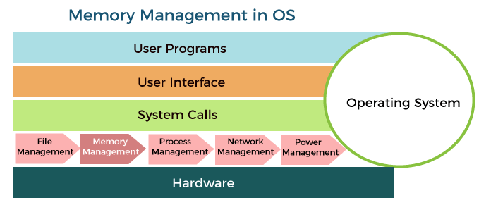
Diagrammatic Representation of Memory Management In OS:

Slide 7
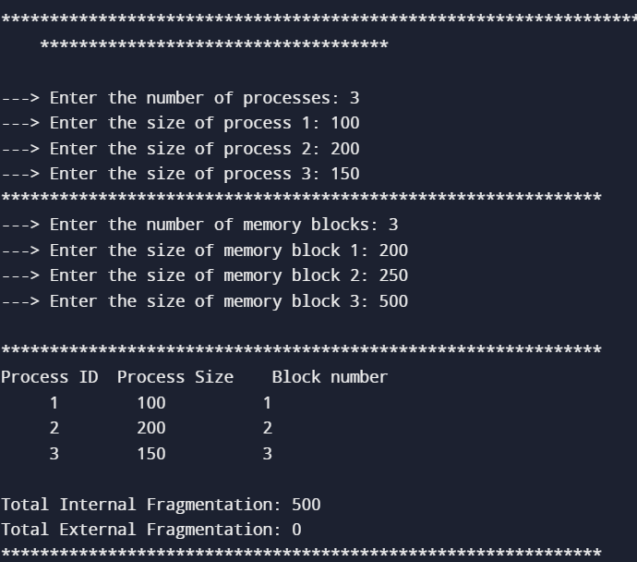
Best Fit Algorithm:

Slide 8
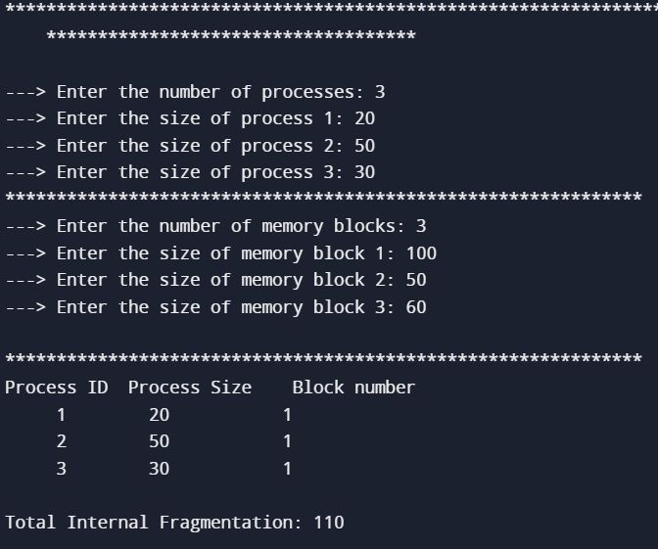
First Fit Algorithm:

Slide 9
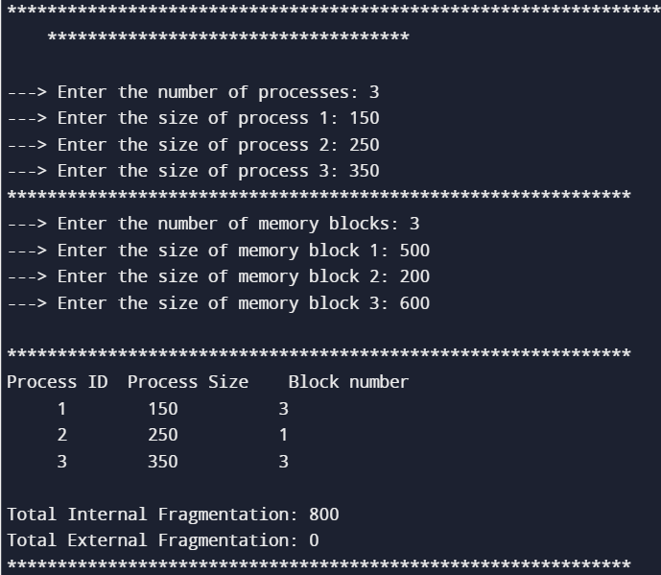
Worst Fit Algorithm:

Slide 10
Conclusion:
In conclusion, the memory management project in operating systems offers a valuable opportunity for participants to deepen their understanding of fundamental principles while honing practical skills in system programming and software development.
The project serves as a stepping stone for further study and exploration in computer science, empowering participants to tackle complex challenges and drive innovation in the ever-evolving landscape of technology.
Through dedication, perseverance, and a spirit of exploration, participants emerge from the project with a deeper appreciation for the intricacies of operating system internals and a readiness to tackle the challenges of tomorrow's technological landscape..

Slide 11


